Slide 1



ELECTRONIC INVOICES
Viettel

Slide 2


CONTENT
1
Electronic invoices and Legal corridor
2
Introduction to electronic invoices solutions of V-invoice
3
Why VIETTEL?
4
Supplying forms electronic invoices of V-invoice
5
Q & A

Slide 3

ELECTRONIC INVOICES AND LEGAL CORRIDOR

Slide 4
LEGAL CORRIDOR
Year | Contents
2005 | Law on e-transactions (no. 51/2005/QH11 date 29/11/2005)
2006 | Information Technology Law (no. 67/2006/QH11 date 29/06/2006)
 | Decree no. 57/2006/NĐ-CP date 09/06/2006 on e- commerce .
2007 | Decree no. 26/2007/NĐ-CP date 15/02/2007- Detailing the implementation of the Law on e-transactions regarding digital signatures and digital signature-certification services.
 | Decree No. 27/2007/ND-CP dated 23/02/2007 of the Government on electronic transactions in financial activities.
2008 | Circular No.78/2008/TT-BTC date 15/09/2008 of the Ministry of Finance guiding the implementation of some contents of the Decree No.27/2007/ND-CP date February 23, 2007 on electronic transactions in financial activities
2010 | Decree No. 51/2010/ND-CP dated May 14, 2010 of the Government providing for goods sale and service provision invoices
2011 | Circular No. 32/2011/TT-BTC dated March 14, 2011 of the Ministry of Finance guiding the creation, issuance and use of e-invoices for goods sale and service provision.
2014 | Circular No. 39/2014/TT-BTC dated March 31, 2014 of the Ministry of Finance on guiding the implementation of the Government’s Decree No. 51/2010/ND-CP of May 14, 2010

Slide 5

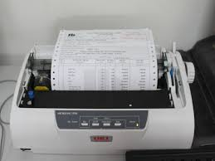

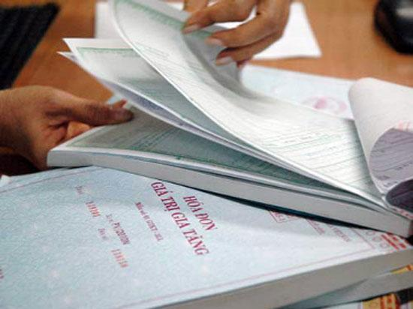
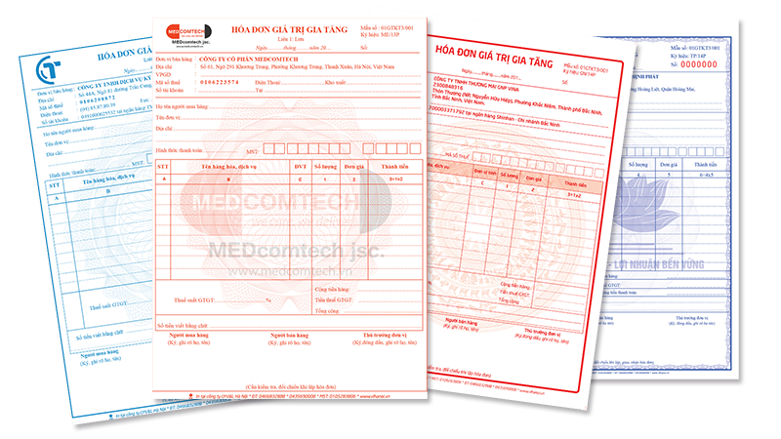
The types of invoices
(Decree no.51/2010/NĐ-CP dated 14/05/2010)
Paper Invoice | Electronic Invoice
Self-printed invoices Invoices printed on order

Slide 6
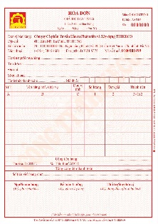
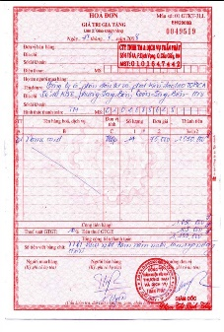


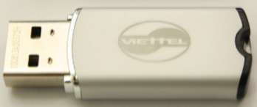
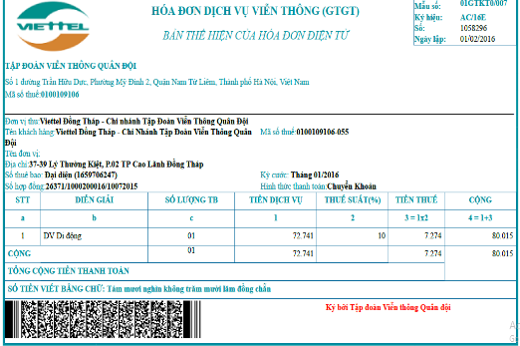
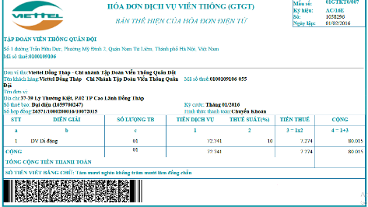
E-INVOICE
Paper Invoice
Electronic Invoice

Slide 7
The differences between Paper Invoice and e-invoice converted into paper
Based on the issues on the invoice. : E-invoice no issues.
Symbol of the invoice:
- E-invoices: E - Invoices printed on order: P
- Self-printed invoices: T
3. E-invoice clearly stating “invoice converted from e-invoice” when e-invoice converted into a paper. 4. Signature of the invoice:
- E-invoice: E-Signature - Paper invoice: signed by hand

Slide 8
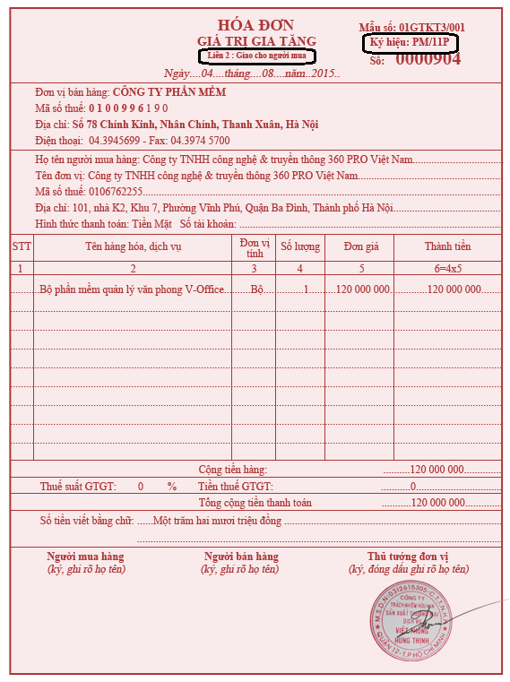
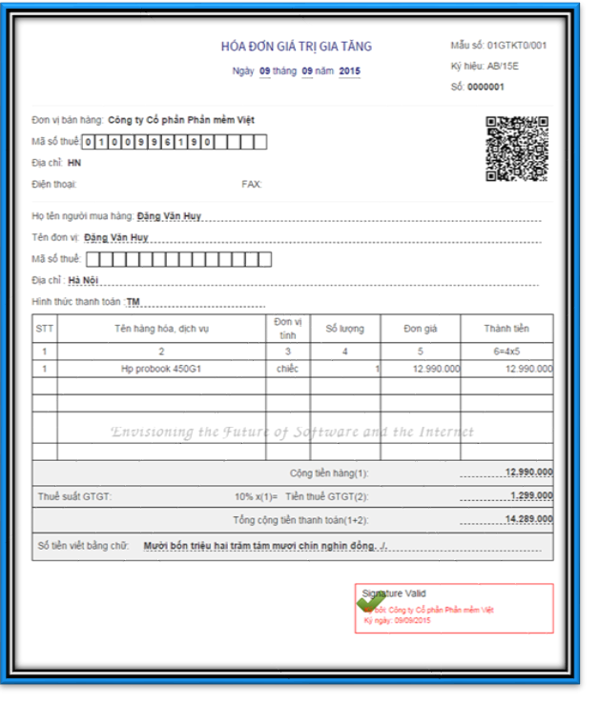
The differences between Paper Invoice and e-invoice converted into paper
Paper invoice
E-invoice converted into paper

Slide 9

Benefits of E-invoices
For Tax office:
Facilitate management
For Enterprise:
Reduce costs on print, send, preserve, store and exploit the invoice.
Proactive in creation and issuance the invoice.
Limiting the risks as loss, torn, broken, burnt during transportation and storage.
Convenient for accounting, reference data, business administration of enterprises, to declare and pay tax..
The preparation, sending and receiving invoice is done via electronic device means , so the time paymen is shortened.
For society:
Environmental protection.

Slide 10



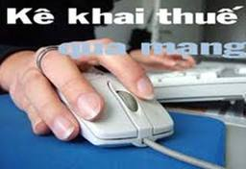
Societal Trends
Consistent with the advanced technology being applied in the world as Mobile Banking, Internet Banking, SMS Banking, ...
The trend of electronic tax
2004
2014
2010

Slide 11
Conditions to use of e-invoices
Users of e-invoices for goods sale and service provision.
Being an economic organization which satisfies the conditions on and is making e-declarations of taxes with a tax office; or being an economic organization conducting e-banking transactions;
Having e-signature under law;

Slide 12

INTRODUCTION TO SOLUTIONS

Slide 13
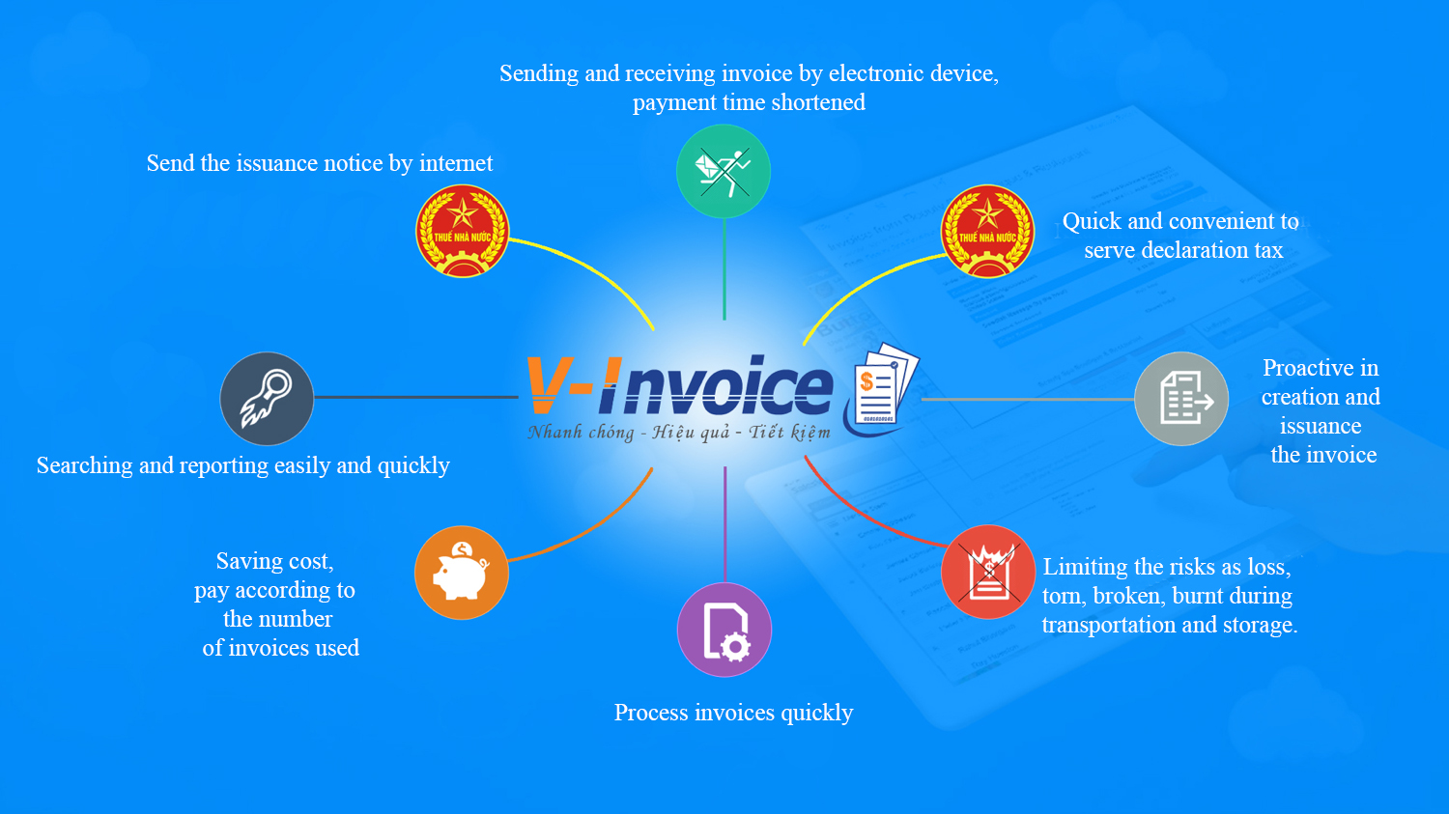
Function of solutions

Slide 14
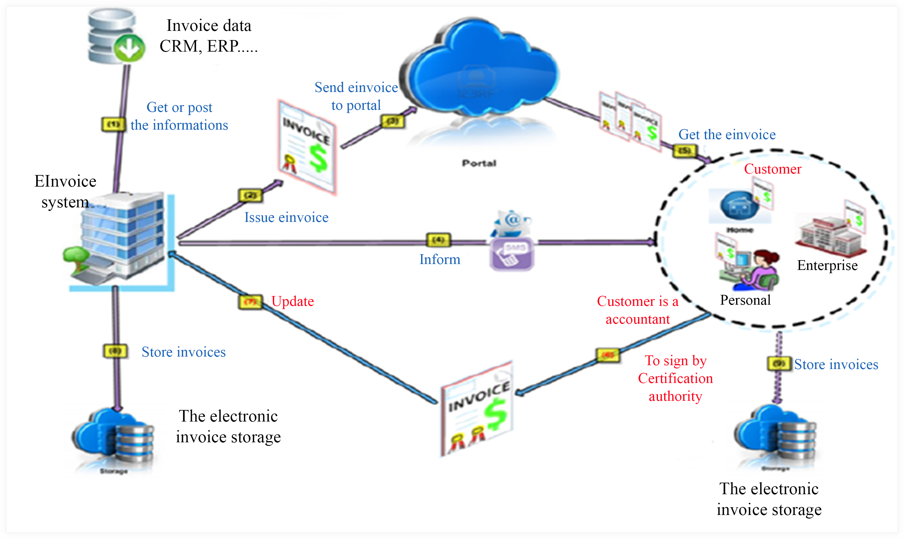
Model with 9 steps

Slide 15
MODELS OF CONNECTIONS

Slide 16
THE FUNCTIONS
ISSUANCE
RECEIPT
CHECK
DECLARE TAX
Handling of billed e-invoices
Storage and Exploitation

Slide 17
ISSUANCE OF E-INVOICES
1. Issuance of e-invoices
ISSUANCE
RECEIPT
Issue a decision on application of e-invoices
Creation the specimen e-invoice Make an e-invoice issuance notice
=>> Send it to its managing tax office (the notice is sent to the tax office in hard copy or electronically through the tax office’s website
CHECK
DECLARE TAX
Handling of billed e-invoices
Storage and Exploitation

Slide 18
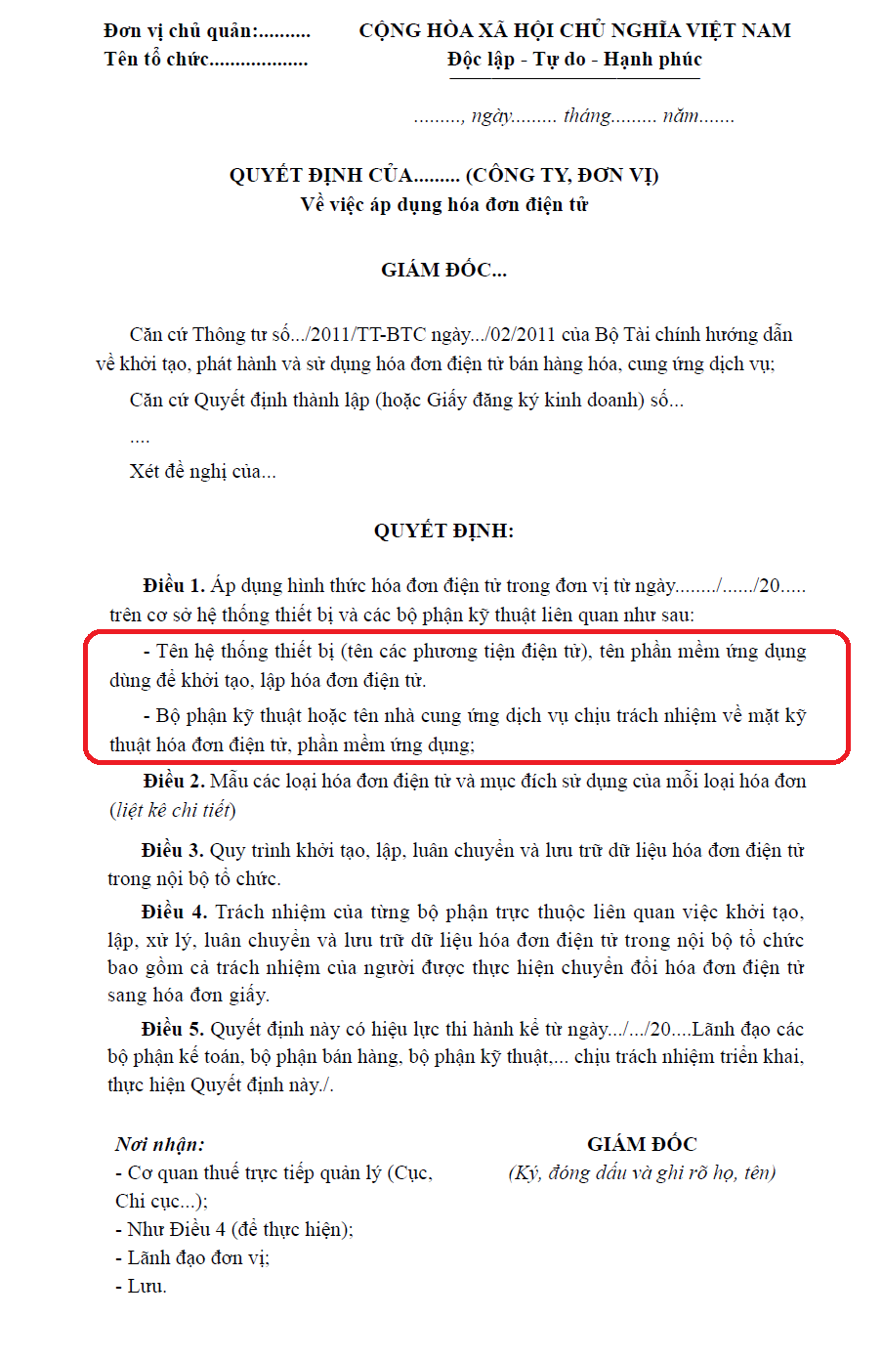
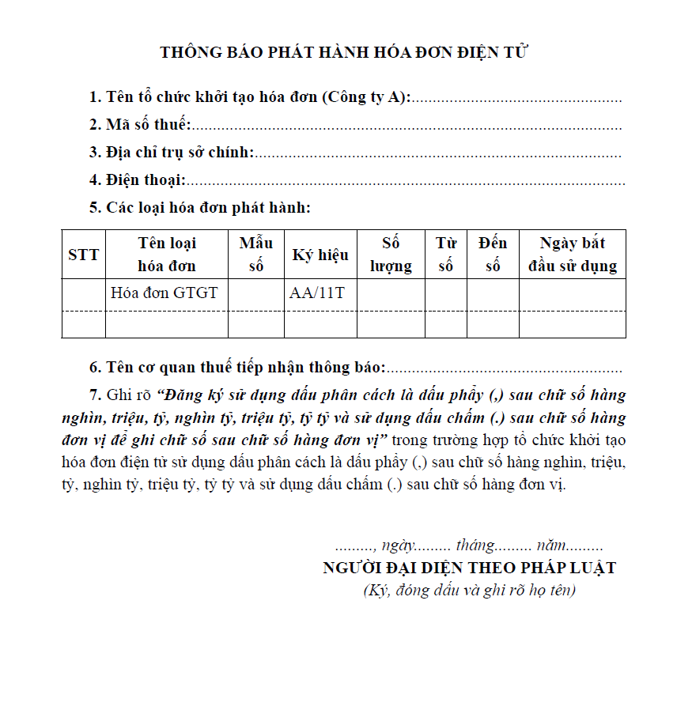
Notes:
18

Slide 19
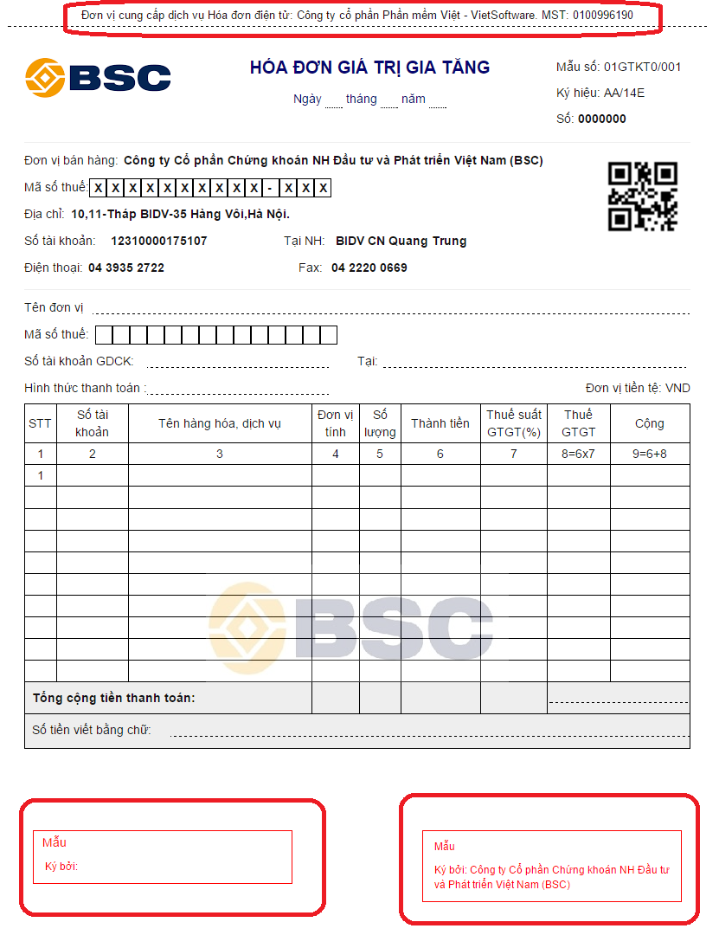
Notes:
19

Slide 20
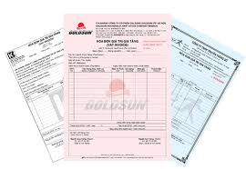

ISSUANCE OF E-INVOICES
2. Issuance of e-invoices
ISSUANCE
RECEIPT
Billing e-invoices data : enter data by hand or connect to related systems such as CRM, software sales, software costs ...
Creation e-invoice
Sign on the invoice: use e-signature which registed in the tax office.
CHECK
Declare Tax
Handling of billed e-invoices
Storage and Exploitation

Slide 21






RECEIPT THE INVOICE
Provide diversity channels
reception invoice for customer.
ISSUANCE
1. Email
RECEIPT
CHECK
2. Web Portal
Declare Tax
3. Mobile
Handling of billed e-invoices
4. Webservices
Storage and Exploitation
5. Tool
Notes:
NIST SP800-30 (Risk Management)

Slide 22
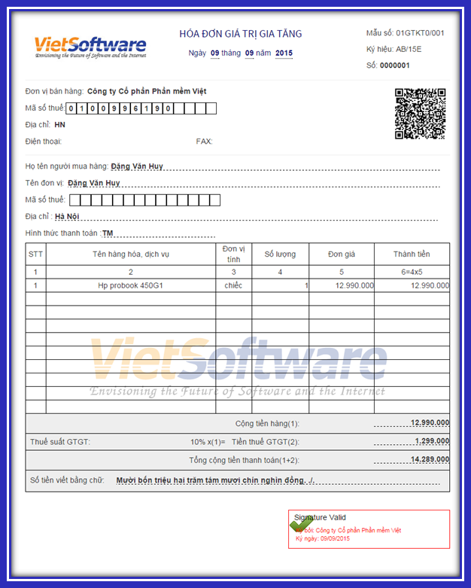
CHECK THE VALIDITY OF THE E-INVOICE
Check e-signature in the invoice
Issuance
Receipt
Check
Declare Tax
Handling of billed e-invoices
Storage and Exploitation

Slide 23
AUTHENTICATE INVOICE & DECLARE TAX
Issuance
Authenticate invoice with the tax office: Chanel for Tax cadre to access to the e-invoice system.
Open connection to system of electronic authentication and transfer invoice data into the national invoice storage .
Reporting on use of the invoice to serve declaration tax.
Reporting on use of the invoices
Table declared invoices every month
Receipt
Check
Declare Tax
Handling of billed e-invoices
Storage and Exploitation

Slide 24


HANDLING OF BILLED E-INVOICES
Conversion of e-invoices
Prove the origin of tangible goods: only once. (As a paper invoice to serve in the circulation )
Storage of accounting documents : unlimited
Provide full processing functions, which related e- invoice original:
Correct
Replace
Cancel
Issuance
Receipt
Check
Declare Tax
Handling of billed e-invoices
Storage and Exploitation

Slide 25
STORAGE AND EXPLOITATION
Issuance
Srorage :
Using the Data Warehouse project.
Ensure a minimum of 10 years storage and retrieval of information invoice every second.
Report - Statistic:
Reporting on use of the invoice
Table declared invoices every month
Detailed table of invoices
Table creation and issuance of invoices.
The situation of signed by the customer.
Receipt
Check
Declare Tax
Reporlyson the handling of billed
List invoices replaced
List invoices corrected
List invoices cancelled
List invoices converted
Handling of billed e-invoices
Storage and Exploitation

Slide 26

DECENTRALIZATION & USER MANAGEMENT
Issuance
Receipt
Check
Declare Tax
Handling of billed e-invoices
Storage & Exploitation
Decentralization & User Management
1. Decentralization in the use of electronic invoicing system after modeled Mother – son:
The mother company is a focus “factory to print the invoice”
The member units / subsidiaries / affiliates: based on tax code to issue invoices.
2. Adjust flexibility decentralization and user management by characteristics of providing goods enterprise :
Export the invoice
Correct the invoice
Report system….

Slide 27

ADVANTAGES OF THE SOLUTION
Matching actual needs:
+ 10 year bill save
+ Express Tax report
+ Quick bill receipt request from customers
Flexible Integration with software related business: Billing, CRM, Accounting etc
Ensured security of the system
+ Authentication: Exactness - Integrity
+ Archives: Security - Safety - Saving
Compliance with the rule of the Law
+ Ministry of Finance
+General Department of Taxation

Slide 28
SUPPLYING FORMS

Slide 29
SOLUTION OR SERVICE
OPTION 1:
Send Invoice directly from the seller to the buyer
VSI: Providing complete solutions or renting software
Enterprise: Self-investment in infrastructure, equipment (servers, HSM)
OPTION 2:
Send Invoices via service providers
VSI:
Providing service
Enterprise:Using the available infrastructure of VSI
Notes:
NIST SP800-30 (Risk Management)

Slide 30



SOLUTION – LICENSE
Consulting, Construct Solutions
Integrating system -> TRAINING + TRANSFER
Preservation, maintenance, upgrades (the versions under the Regulations of the Tax Authority - Ministry of Finance) and adjust business according to the situation of the enterprise.
PROVIDER
DỊCH VỤ
ENTERPRISE
Self-investment in infrastructure, equipment (hardware + supporting software)
Actively operating, administrating system
Self storage, preservation electronic invoice according to the Regulations
Notes:
NIST SP800-30 (Risk Management)

Slide 31
SERVICE
Integrating electronic invoice system with business systems
Providing Portal to receive electronic invoice and Tool to manufacture electronic invoice
Providing infrastructure: servers, transmission lines, sign of HSM
Archiving electronic invoice issued: 1 year
PROVIDER
ENTERPRISE
Receiving and using all the system
Actively released electronic invoice
Management, statistics and reporting
Storage and preservation of invoices under regulation
Notes:
NIST SP800-30 (Risk Management)

Slide 32
WHY VIETTEL?

Slide 33
Why Viettel
Synchronized and integration system (CRM/ERP/BI Integration)
Flexible Deployment plan (Software/Infrastructure as a Service)
Deployment Experience
(VNR500, SME)
Multi-platform security (Sim CA, OTP Token, Data Encryption)
Nationwide customer support (Customer service 24/7)
Notes:
5 points: as Viettel is Telco

Slide 34
AFFIRMING THE DIFFERENCE
Electronic Signing: To sign up for individual or batch
Ensure the legality of the bill
Ensure data integrity after invoice issued (no edit/delete, reject)
Electronic Signing Speed: Bill batch (multiple bills at once)
Storage: The XML format for invoice
Small capacity → save the investment cost for storage (10 years)
Easy to combine "EMBED" with the business applications involved
Diversifying forms of deployment
For an independent company
For companies operating in the model of parent company / subsidiaries (The Group, Corporation ...)
Diversifying channel to send / receive electronic invoice
Mail, Web
Web services, Tool, Mobile …
Notes:
NIST SP800-30 (Risk Management)

Slide 35
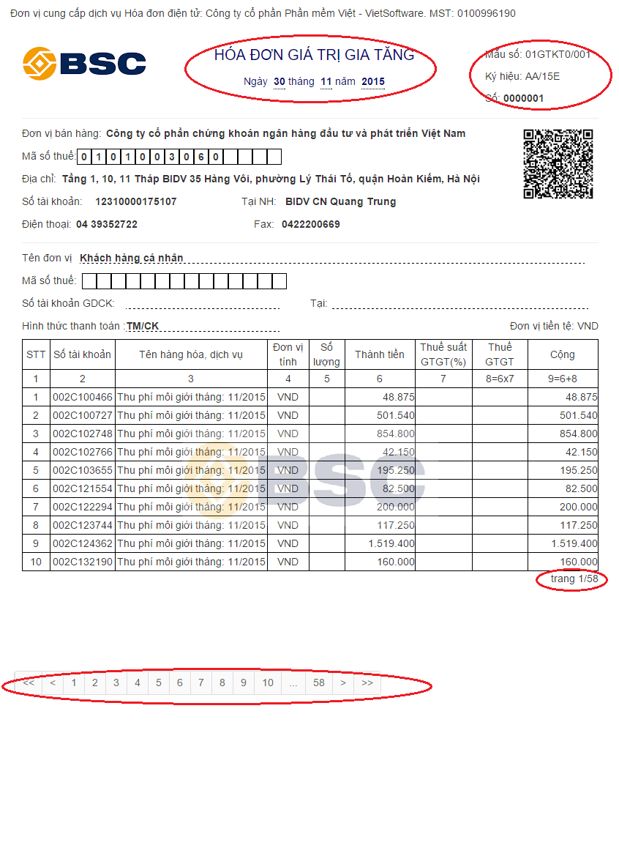
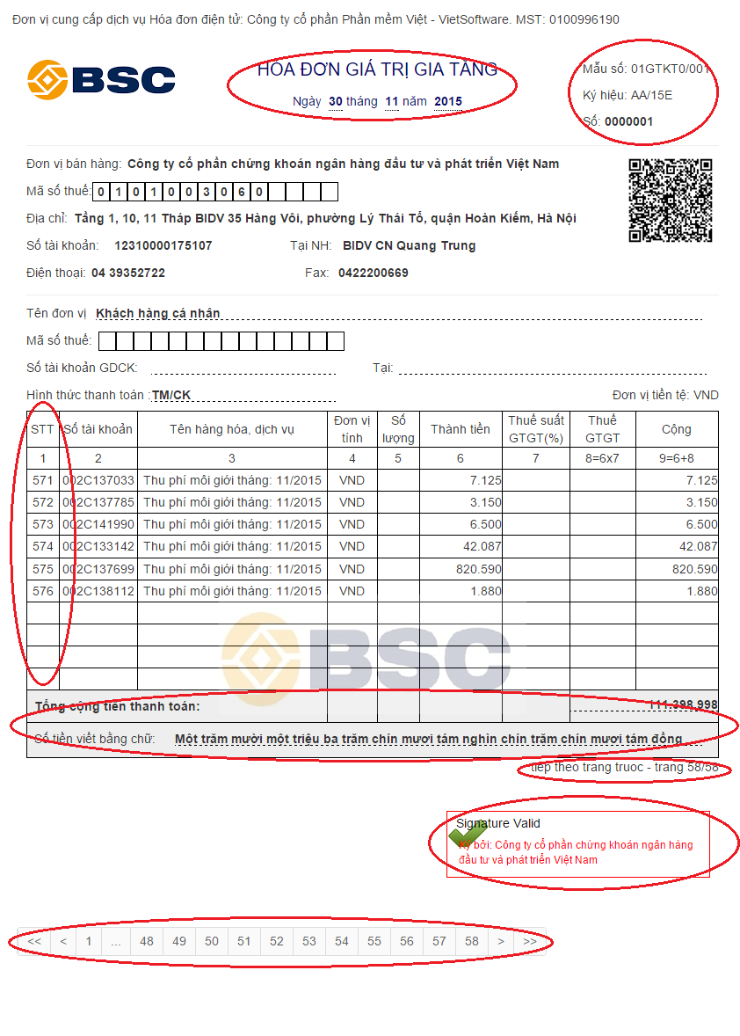
MULTIPLE-PAGE INVOICES
HÓA ĐƠN NHIỀU TRANG
Notes:
35

Slide 36



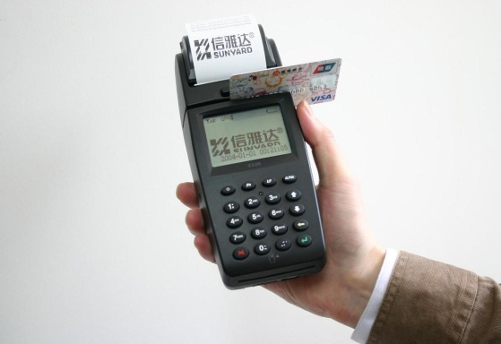
Confirm the difference
Combining affirm electronic charges
2. Combined receipt
Earning Money -> Deleting debt -> Printing receipts -> electronic invoice
Notes:
NIST SP800-30 (Risk Management)

Slide 37
THANK YOU !

